Slide 1





GROUP TITLE : MEDICAL DIAGNOSIS
GUIDE’S NAME: Prof. Pooja Patil
GROUP MEMBERS
Dipak Baidya -- 22285
Rohit Temkar -- 22284
Pradeep Bhosale -- 22260
Shubh Pyasi -- 22279

Slide 2

INTRODUCTION
Brief Overview of the Project
The Medical Diagnosis System is designed to predict diseases such as heart disease , Kidney Disease, Breast Cancer, and Liver Disease using Machine Learning. It integrates a user-friendly frontend, a Flask-based backend, and pre-trained ML models to provide accurate predictions.
Objective of the Project
The primary goal is to develop an efficient, accurate, and scalable medical diagnosis tool that assists users in early disease detection, helping improve healthcare outcomes.
Importance and Relevance
Early diagnosis can lead to better treatment and management.
Machine Learning improves prediction accuracy and efficiency.

Slide 3
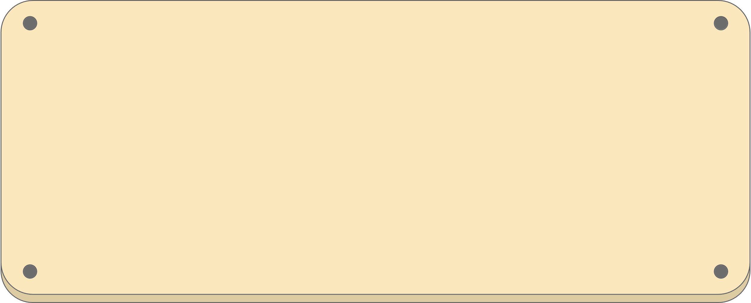
PROBLEM STATEMENT
Problem Definition
Late diagnosis of diseases like Heart disease, Kidney Disease, Breast Cancer, and Liver Disease leads to severe health risks.
Traditional methods are slow, costly, and require expert interpretation.
Limited healthcare access in remote areas delays early detection.
Target Users
Doctors & Hospitals – Decision support tool.
Patients & Public – Early health assessment.
Researchers – Analyzing disease patterns.

Slide 4
EXISTING SYSTEM AND CHALLENGES & LIMITATIONS
Existing System
Traditional manual diagnosis relies on medical tests, doctor consultations, and physical examinations.
Lab tests & imaging techniques (e.g., blood tests, biopsies, X-rays) are commonly used.
Requires specialist interpretation, which can be time-consuming and expensive.
Challenges & Limitations
Time-Consuming – Diagnosis can take days or weeks.
Human Errors – Misinterpretation of test results can lead to misdiagnosis.
Late Detection – Many diseases are diagnosed at advanced stages, reducing treatment

Slide 5
PROPOSED SYSTEM
Proposed System Features of the New System:
AI-powered disease prediction using machine learning.
Web-based interface for easy access.
Fast & automated diagnosis with real-time results.
Improves early detection & treatment outcomes
How It Solves the Problem
Provides quick & accurate disease detection.
Eliminates dependency on specialists for initial screening.
Accessible anytime, anywhere, reducing delays in diagnosis.

Slide 6
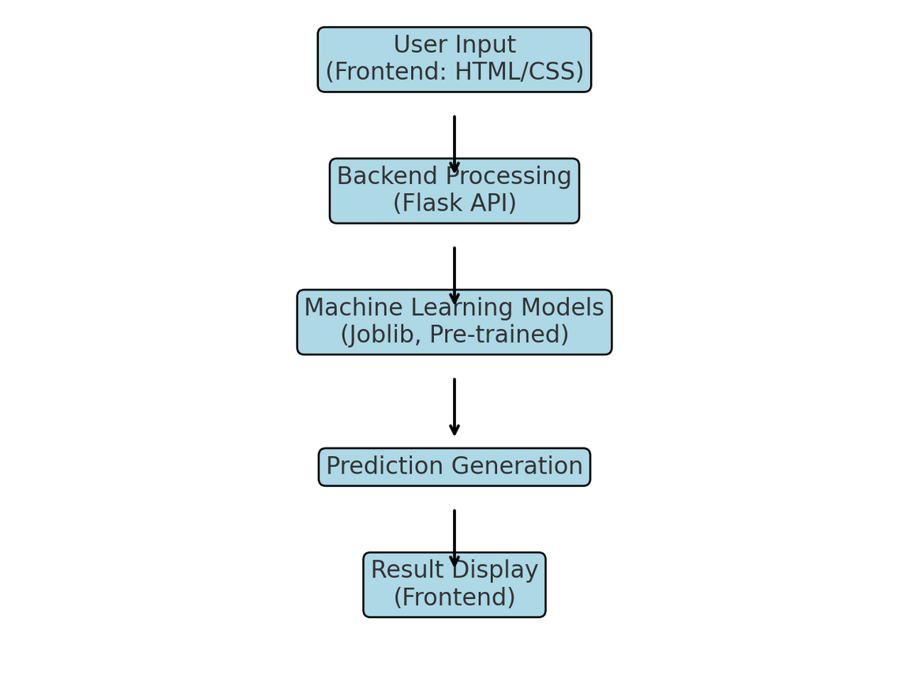
SYSTEM ARCHIETECTURE
Flow of the System
1️⃣ User Input → Patient enters medical data via the frontend (HTML/CSS).
2️⃣ Backend Processing → Data is sent to the Flask API, which loads the appropriate ML model (Joblib).
3️⃣ Prediction Generation → The trained model analyzes data and predicts the disease outcome.
4️⃣ Result Display → The diagnosis result is sent back and shown on the frontend.

Slide 7
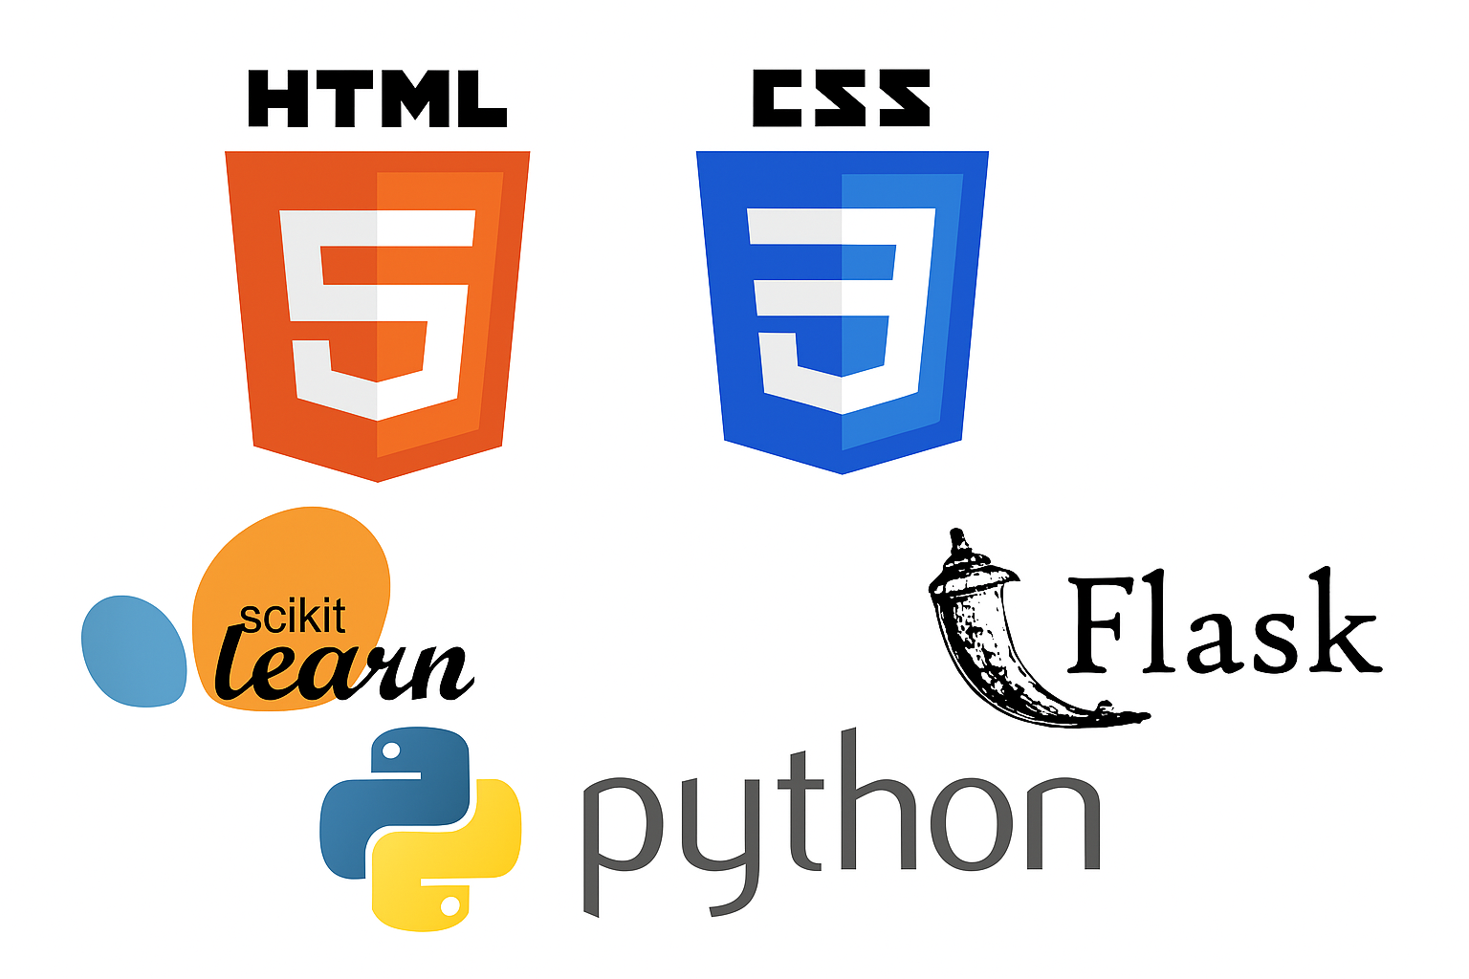
TECHNOLOGIES USED
Programming Languages
Python – Used for backend and machine learning models
HTML, CSS(bootstrap) – Frontend design
java script
Other Tools & APIs
Flask API – For communication between frontend and backend
NumPy & Matplotlib – Data handling and visualization
Frameworks & Libraries
✔ Flask – Backend framework to connect frontend and ML models
✔ Scikit-learn & Pandas – Machine learning and data processing
✔ Joblib – Model serialization and storage

Slide 8

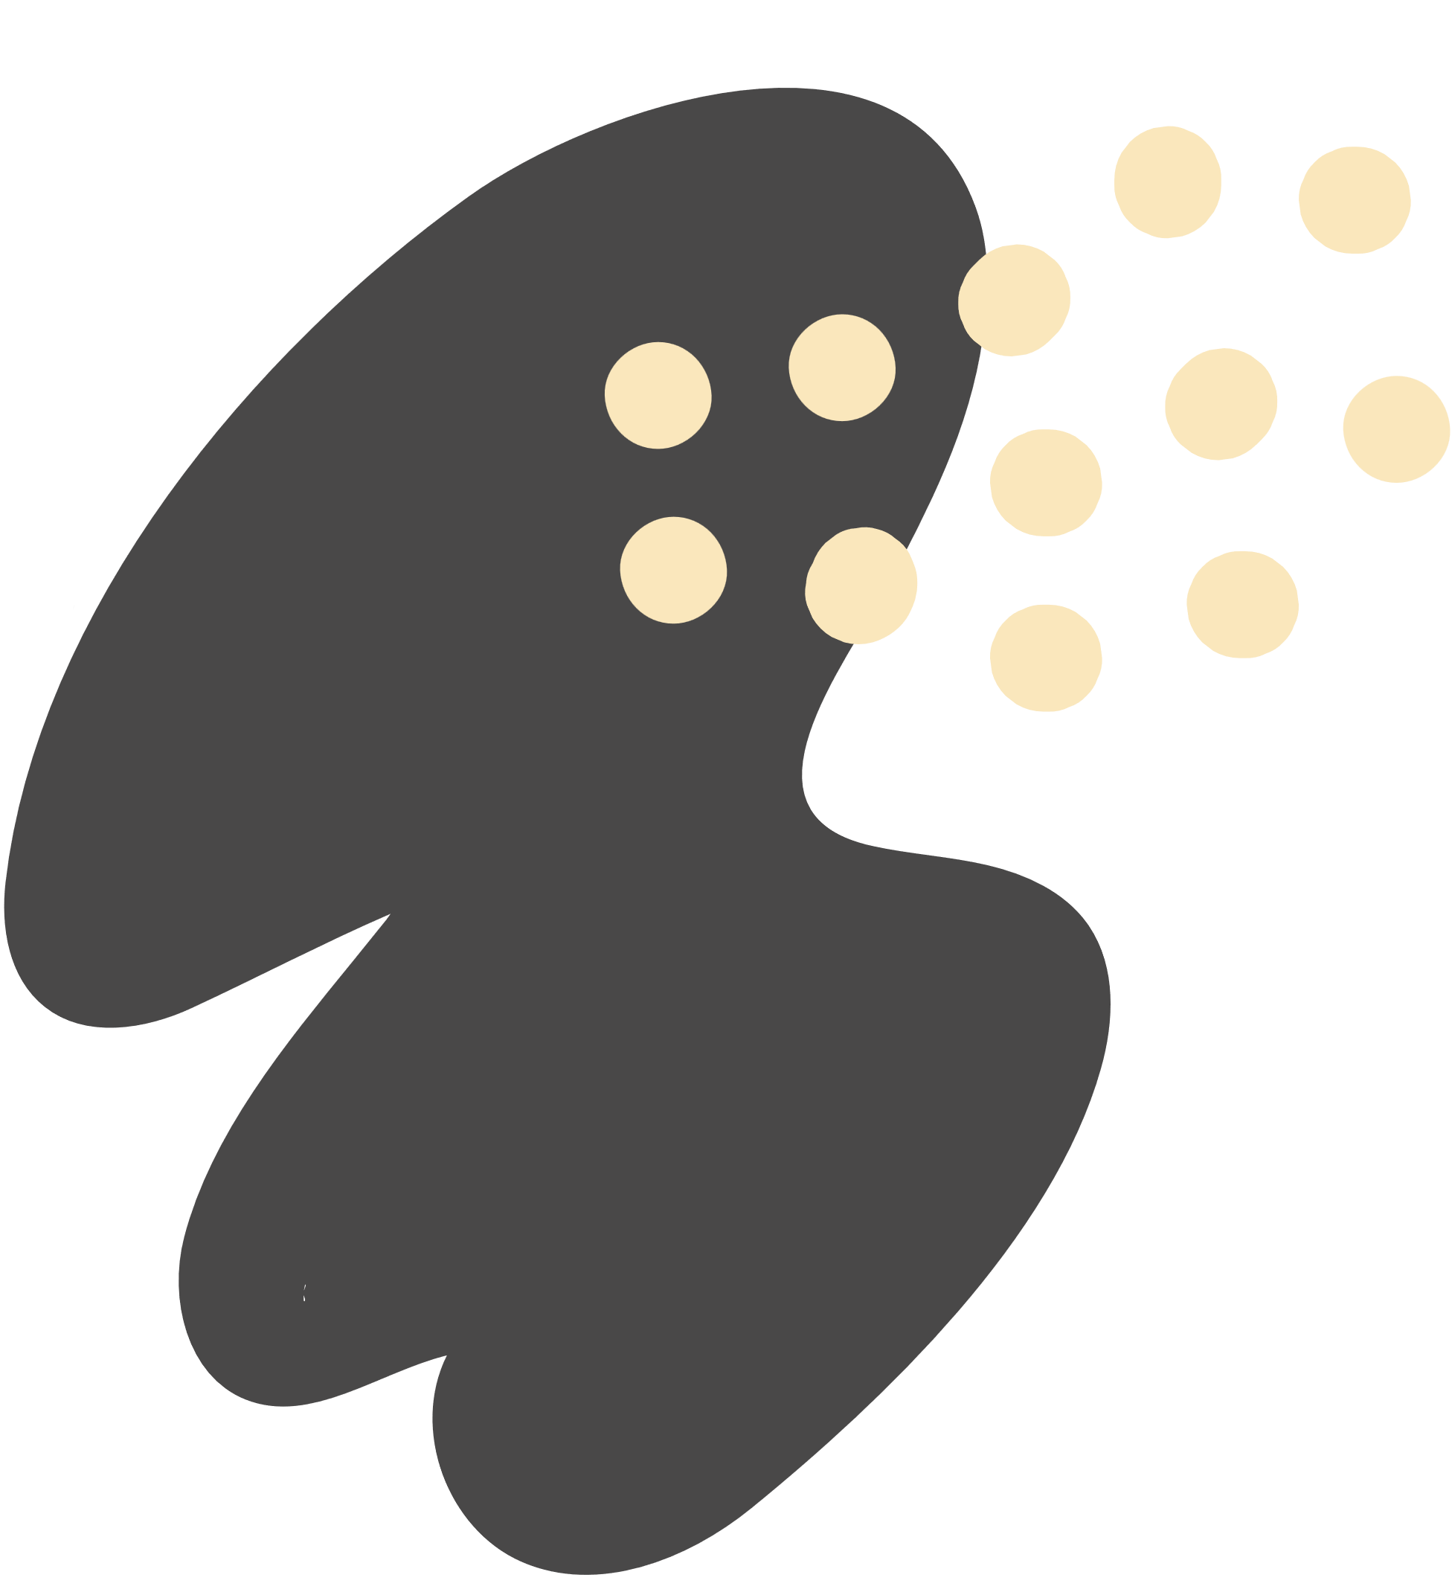
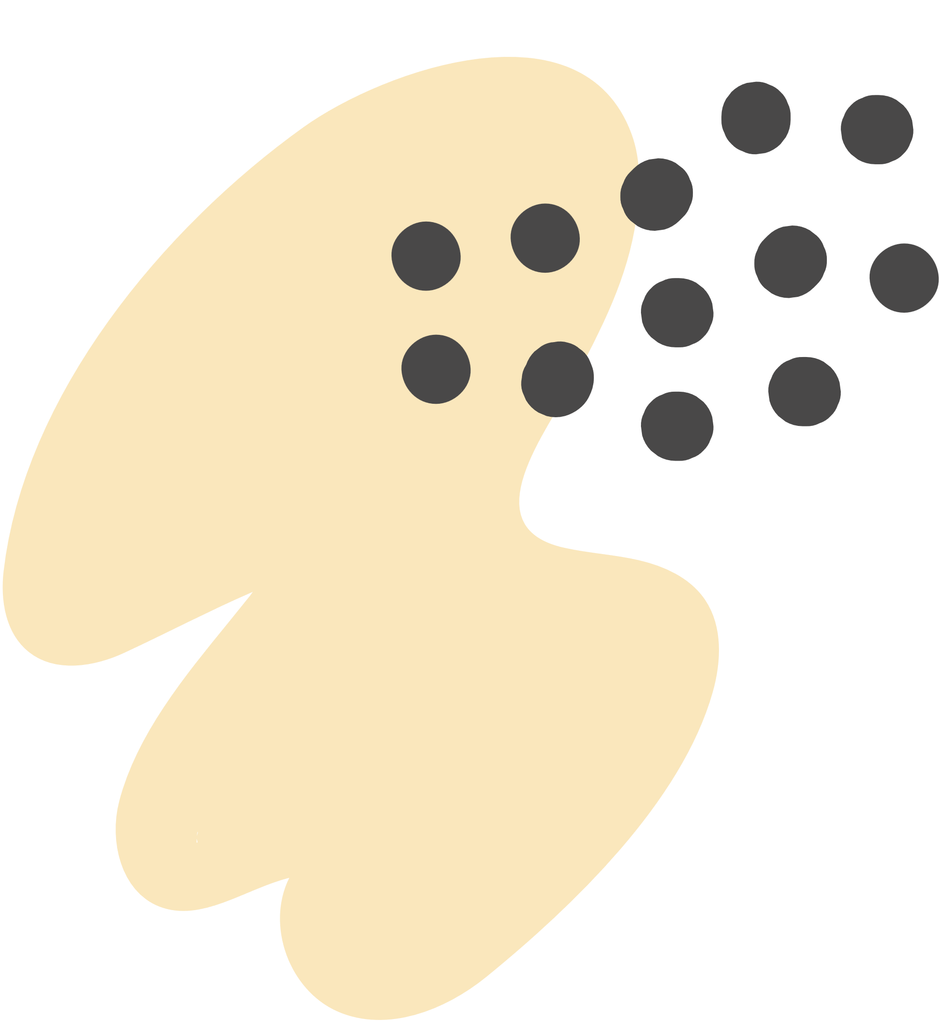
MODULE OF THE PROJECT

Slide 9
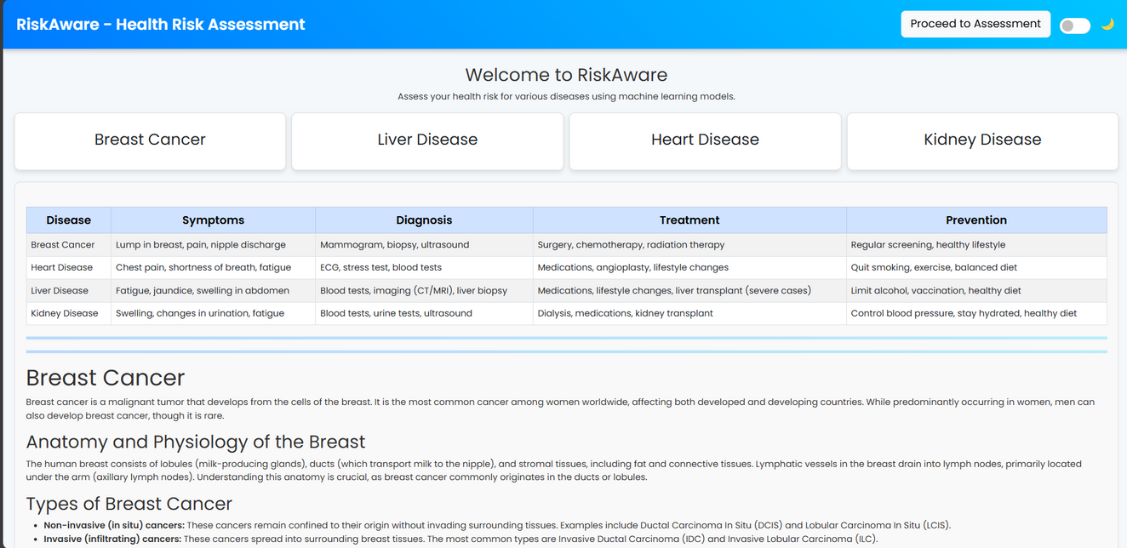
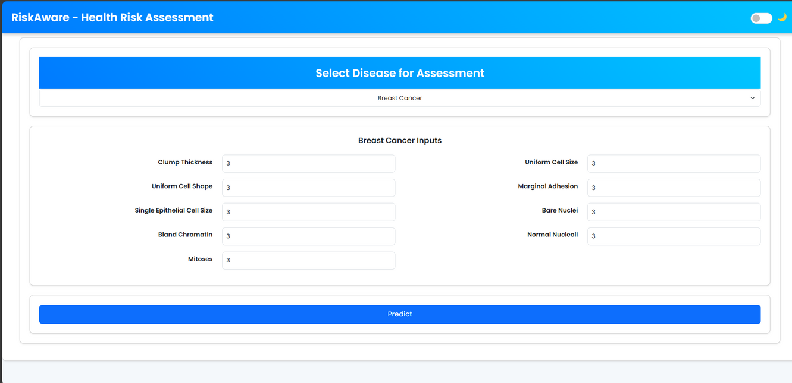
DASHBOARD
DISEASE SELECTION &
INPUT

Slide 10
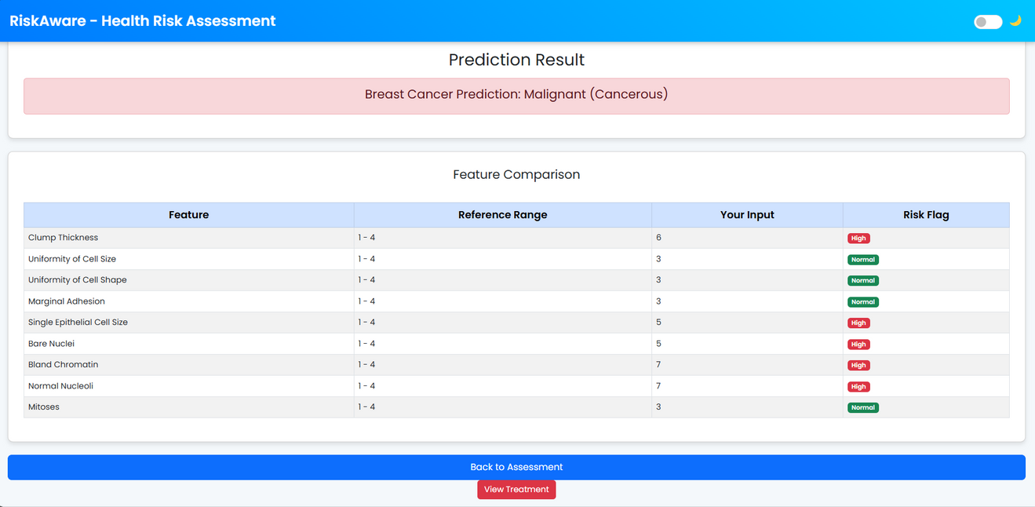
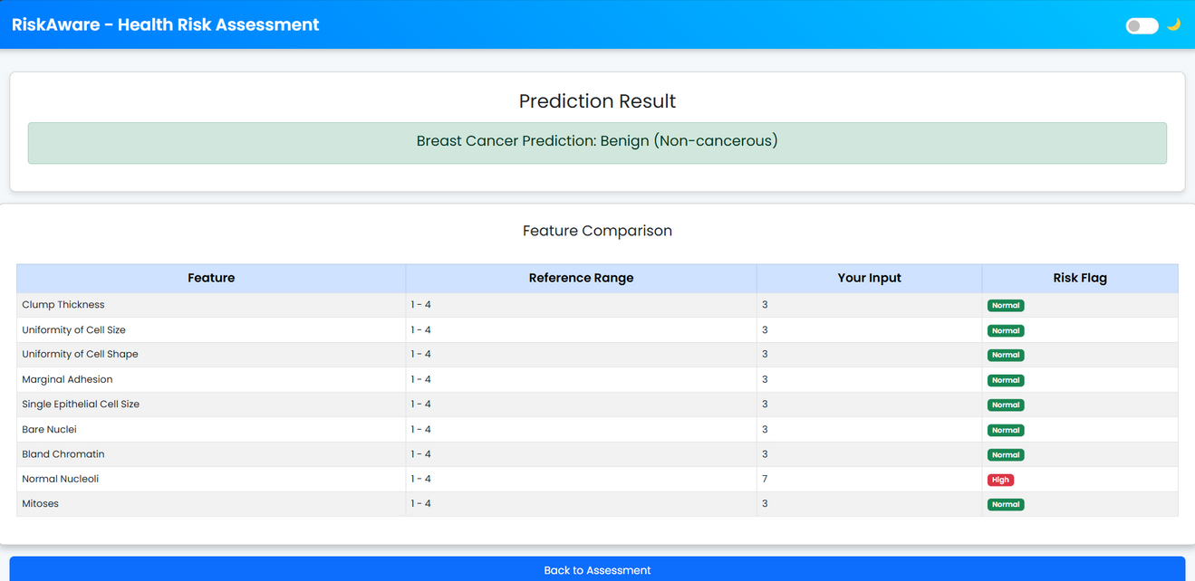
CANCEROUS
NON - CANCEROUS

Slide 11
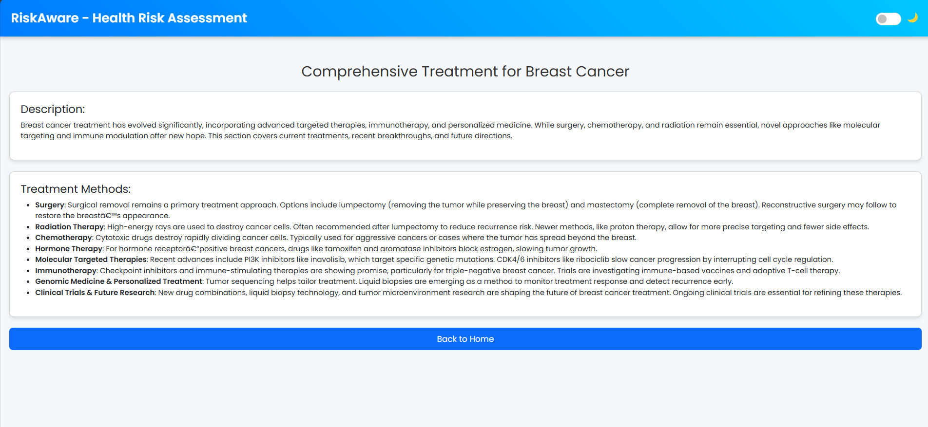
CURE

Slide 12
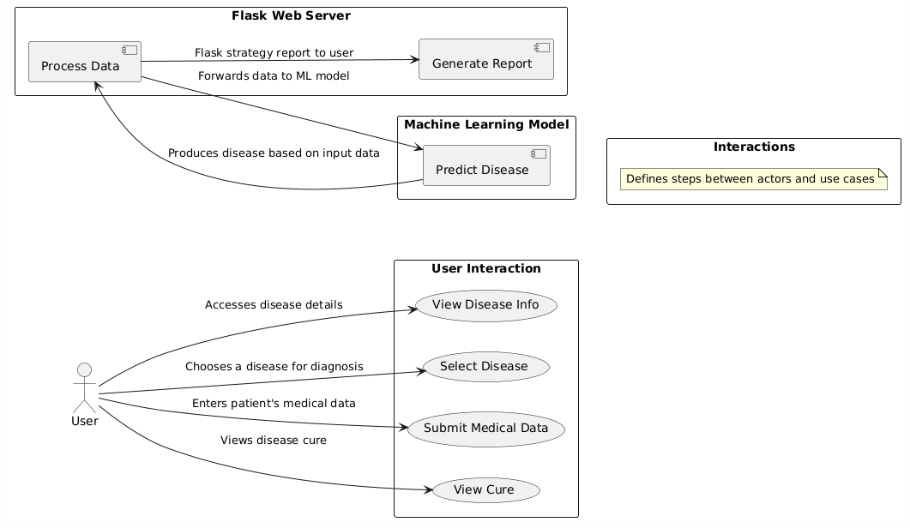
UML DIAGRAMS
USE CASE DIAGRAM

Slide 13
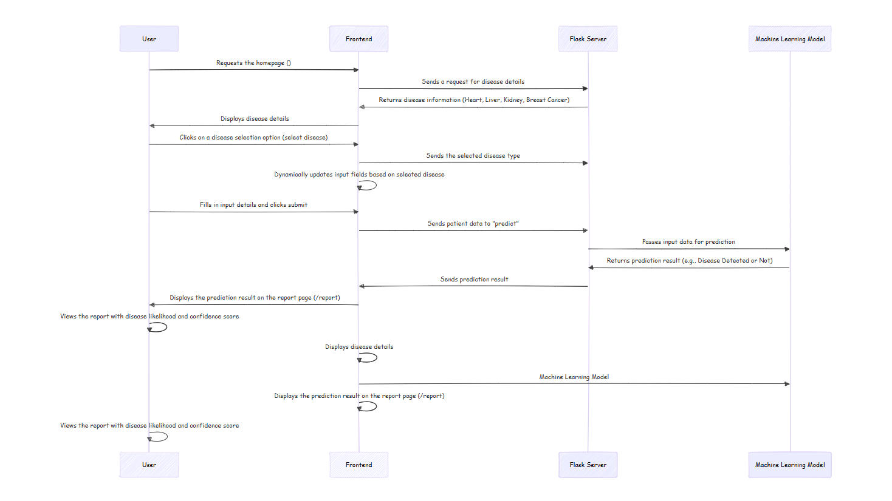
SEQUENCE DIAGRAM

Slide 14
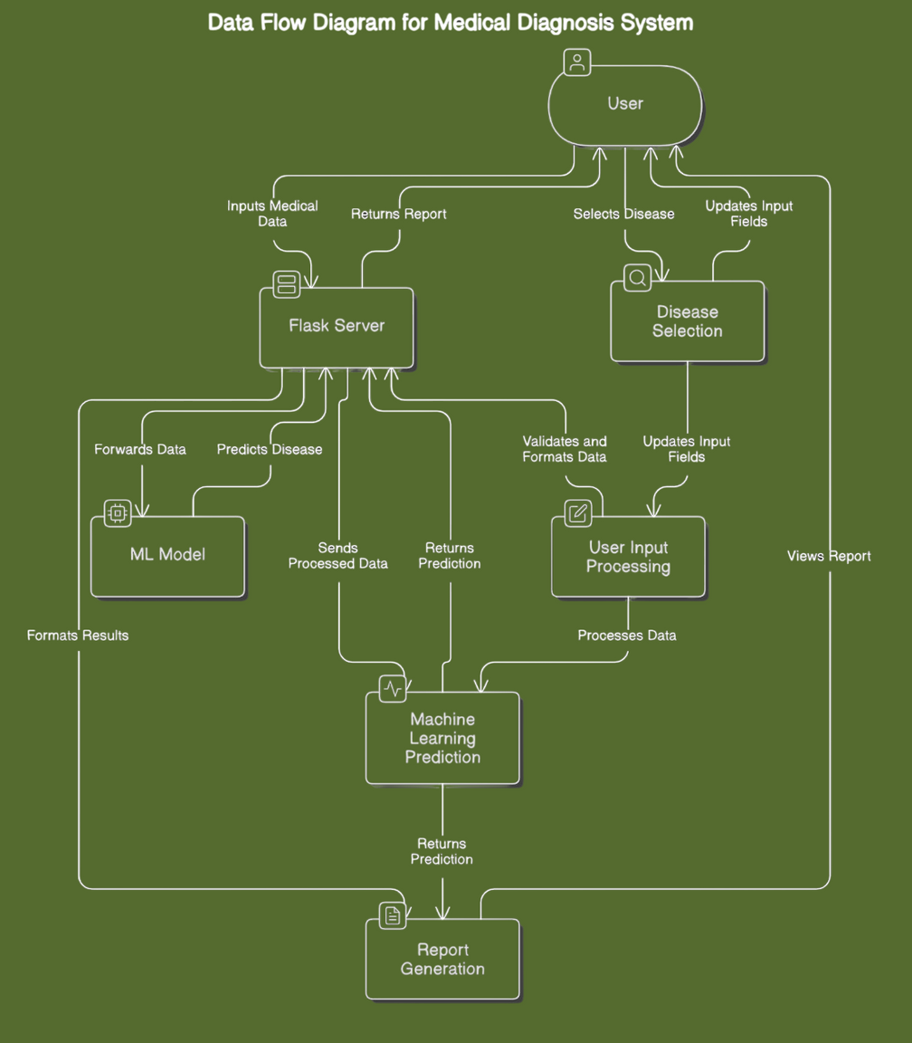
DATA FLOW DIAGRAM

Slide 15
WHITE BOX TESTING
White Box Testing is a software testing method that involves testing the internal structures or workings of an application. Unlike Black Box Testing, testers need to have knowledge of the code and are able to create test cases based on the internal logic of the system.
Unit Testing: It is a software testing technique that verifies individual components or functions of a system to ensure they work as expected.
Control Flow Testing: It is a software testing technique that examines the logical flow of a program through different paths to ensure all conditions and loops function correctly.
Path Testing: It is a software testing technique that ensures all possible execution paths in a program are tested at least once to detect errors and improve code coverage.

Slide 16
BLACK BOX TESTING
Black Box Testing is a software testing method that focuses on the functionality of an application without any knowledge of its internal code structure, implementation details, or logic. Testers evaluate the system from an external perspective, ensuring that it behaves as expected based on defined requirements and specifications.

Slide 17
CHALLENGES FACED
Difficulties Encountered
Data Quality Issues – Handling missing or inconsistent medical data.
Model Accuracy – Ensuring high precision in disease prediction.
Frontend & Backend Integration – Connecting the ML model with the user interface.
Deployment Challenges – Hosting and running the Flask API efficiently.
How We Overcame Them
Data Preprocessing – Cleaned and standardized data for better accuracy.
Hyperparameter Tuning – Optimized ML models for improved performance.
Flask API Implementation – Enabled smooth communication between frontend and backend.

Slide 18
FUTURE ENHANCEMENTS
Possible Improvements
Increase Accuracy – Enhance ML models with more diverse datasets.
Add More Diseases – Expand predictions to cover additional medical conditions.
Improve UI/UX – Make the interface more user-friendly and interactive.
Scalability Options
Cloud Deployment – Host the system on cloud platforms for wider accessibility.
Mobile App Integration – Develop a mobile version for easy diagnosis on the go.
Real-time Data Processing – Implement live data analysis for instant results.

Slide 19
CONCLUSION
Summary of Findings
Developed an AI-powered medical diagnosis system for early detection of diseases.
Integrated machine learning models with a Flask-based backend and a user-friendly frontend.
Provides fast, accurate, and cost-effective predictions compared to traditional methods.
Impact of the Project
Enhances early diagnosis, leading to better treatment outcomes.
Reduces dependency on specialists, making healthcare more accessible.
Scalable and efficient, with potential for future improvements and wider adoption.

Slide 20
QNA

Slide 21
THANK YOU

